Slide 1




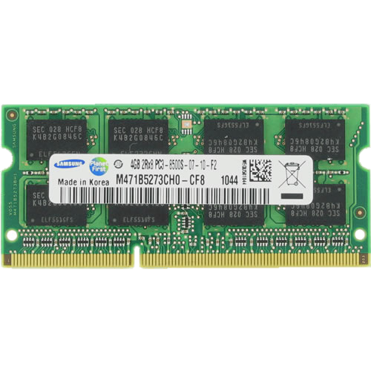
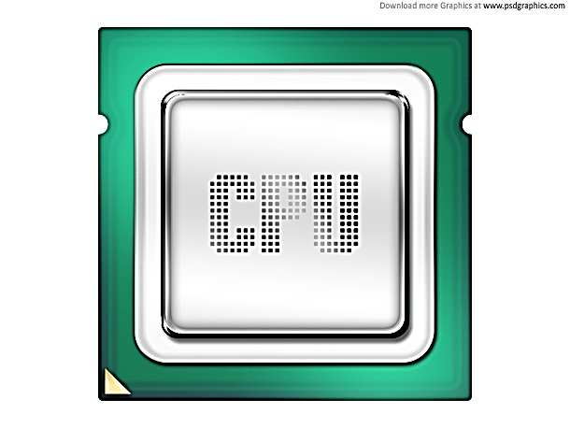
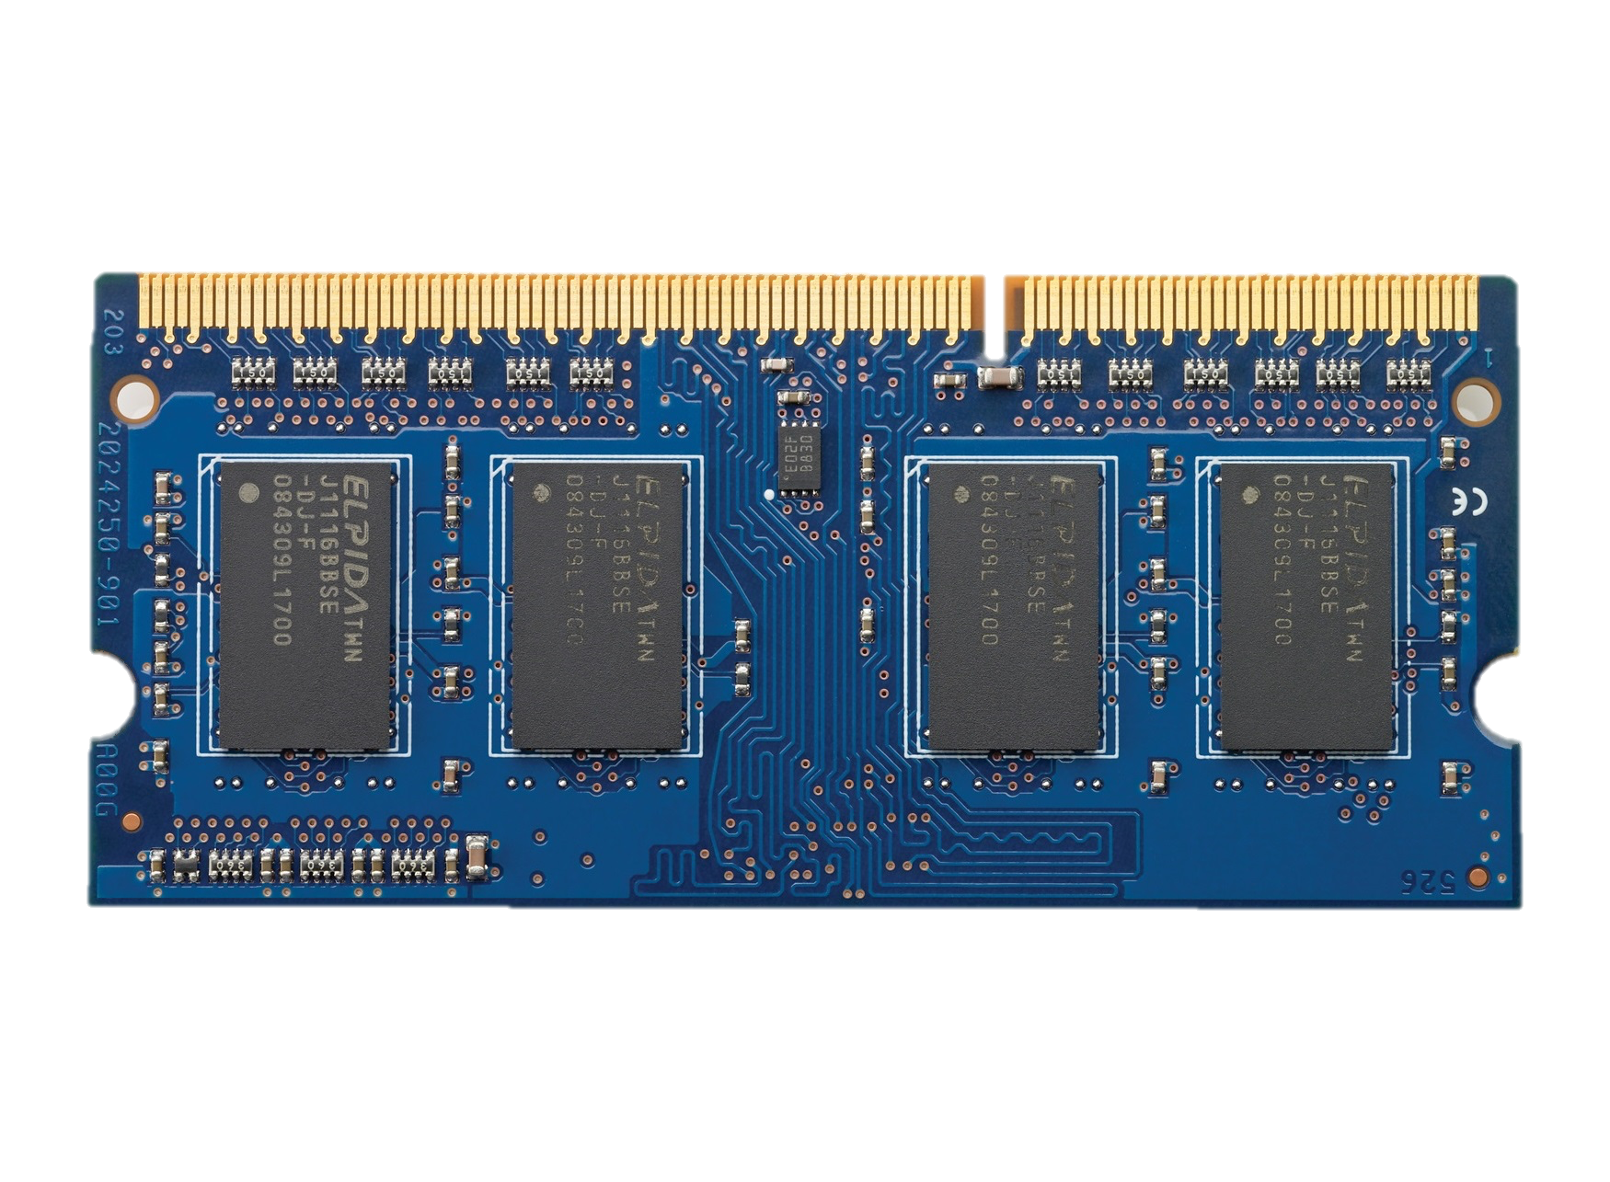

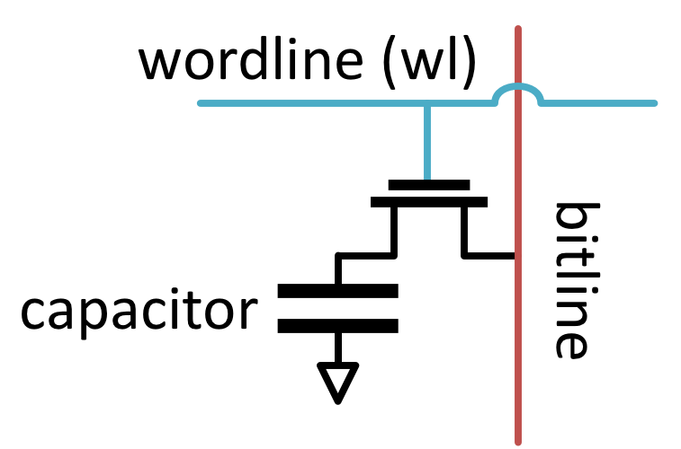





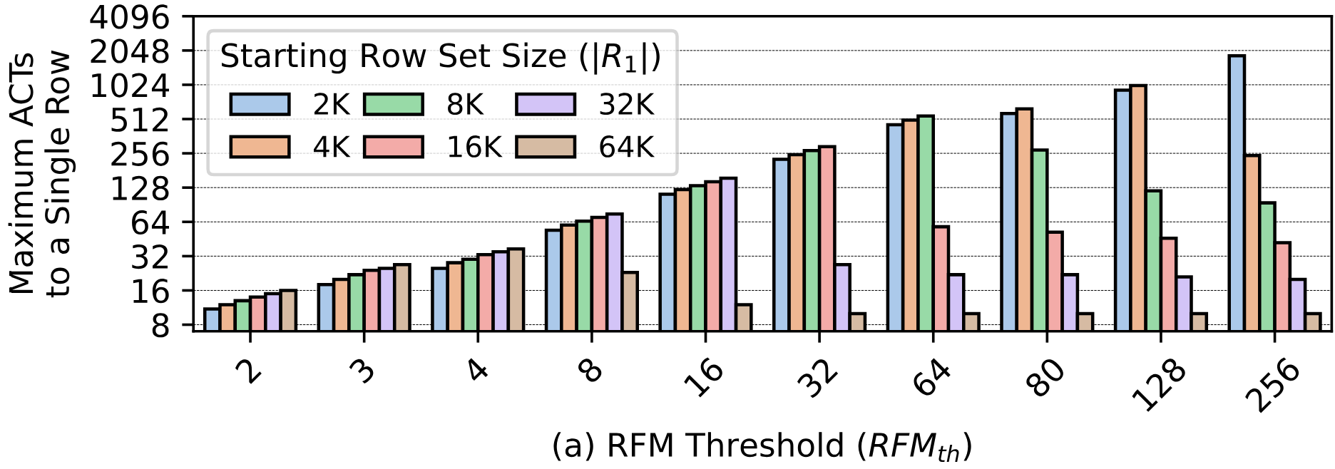
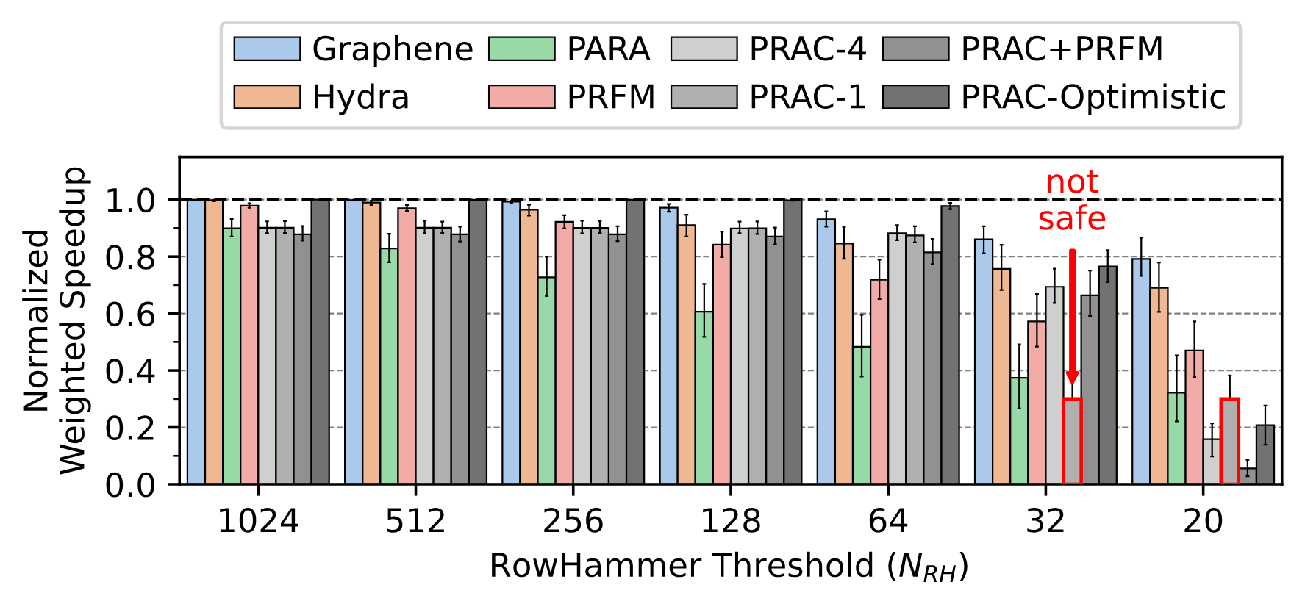
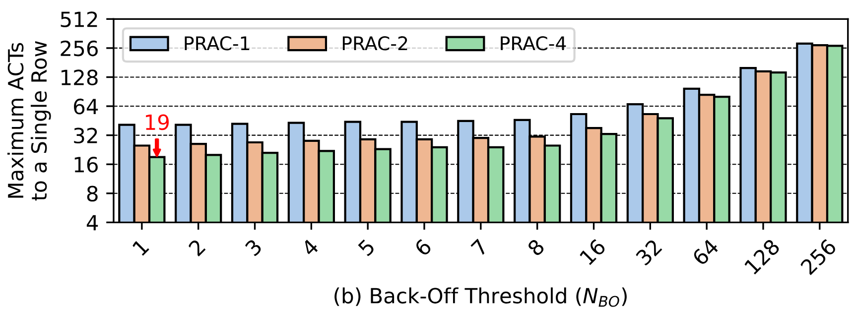


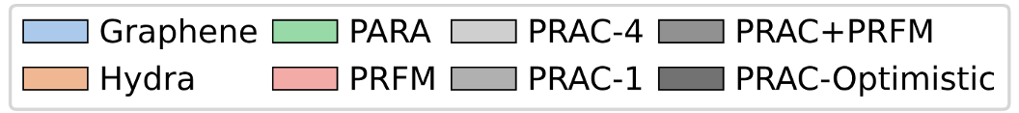
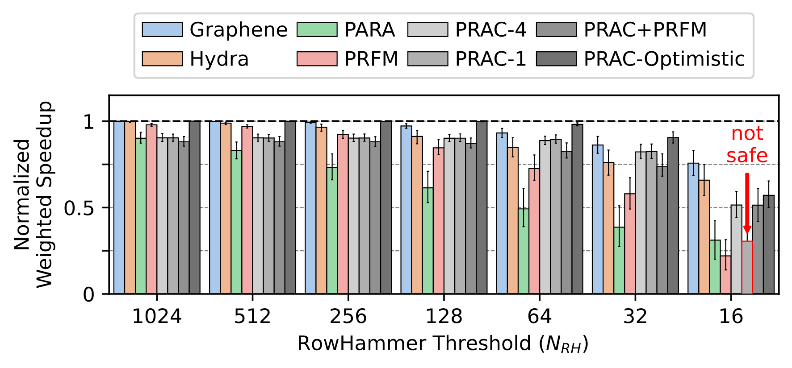

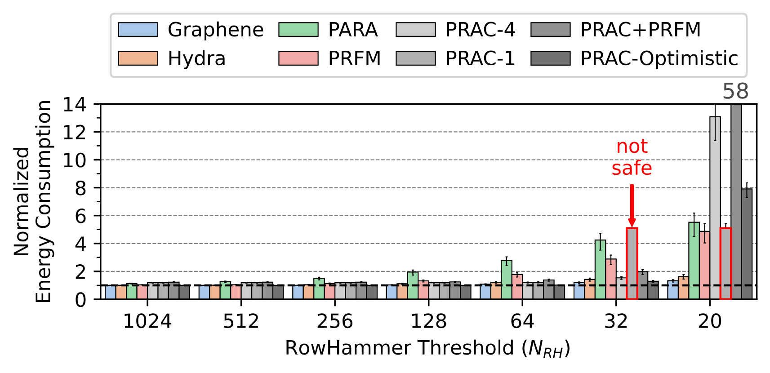
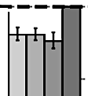
Understanding the Security Benefits and Overheads of Emerging Industry Solutions to DRAM Read Disturbance
Contact Info
Oğuzhan Canpolat A. Giray Yağlıkçı Geraldo Oliveira Ataberk Olgun Oğuz Ergin Onur Mutlu
Full Paper
1. DRAM Background
2. Cutting Edge Industry Solutions
DRAM Organization
DRAM Read Disturbance
Preventive Refresh in DDR5 Specifications
DRAM Subarray
RowHammer
[Kim+ ISCA’14]
Preventive refresh is a blocking operation
Row 0
Repeatedly opening and closing
OR keeping open
a DRAM row causes
bitflips in nearby cells
ACT
Row 0
Victim Row
Row 1
Row 1
Row 1
Bank
bitline
DRAM Cell
wordline
Victim Row
RowPress [Luo+ ISCA’23]
RFM
Row 2
Row 2
Row 2
Row 2
open
Chip I/O
…
closed
Aggressor Row
DRAM Module
…
Row 3
Memory controller sends an RFM command
to allow time for preventive refreshes
Row 3
Row 3
…
…
…
…
Victim Row
Row 4
Row 4
Row Buffer
Victim Row
Periodic Refresh Management (PRFM)
Modern DRAM chips are more vulnerable
Defenses are becoming prohibitively expensive
DRAM Chip
DRAM Bank
SA₀
SA₁
…
SA_{N-1}
[Kim+, ISCA’14]
Memory controller periodically issues RFM commands
To gain insights into DRAM read disturbance and its fundamental properties
Counts the number of times a hardware thread triggers a RowHammer-preventive actions (e.g., preventive refreshes)
Slows down suspect threads by reducing the number of miss status holding registers (MSHR) they can allocate in the last level cache (LLC)
Sense Amplifiers (SAs)
[Kim+, ISCA’20]
Per Row Activation Counting (PRAC)
Sense
Amplifier
[Luo+, ISCA’23]
DRAM chip tracks row activations for each row and requests RFMs by sending back-off signals
DRAM Cell
To prevent RowHammer efficiently, scalably and with no proprietary information
100
BreakHammer
Last
Level Cache
BreakHammer
3. Per Row Activation Counting (PRAC) [JEDEC, JESD79-5C, April 2024]
4. Performance Evaluation
10
MSHR
Limit
Cycle-level simulations using
Ramulator 2.0 [Luo+, CAL 2023] DRAMPower [Chandrasekar+, DATE 2013]
System Configuration: Processor 4 cores, 4.2GHz clock frequency, 4-wide issue, 128-entry instruction window DRAM DDR5, 1 channel, 2 rank/channel, 8 bank groups x 4 banks x 64K rows Memory Ctrl. 64-entry read and write requests queues, FR-FCFS scheduling with a column cap of 4 Last-Level Cache 8 MiB (4-core)
Workloads: 60 mixes from SPEC CPU2006,
SPEC CPU2017, TPC, MediaBench, and YCSB
Memory
Controller
ACT
Memory
Controller
Counters
DRAM Rows
1
PRFM
7
0
Back-Off
Memory controller periodically issues RFM
PREF
0
101010101010101010101010
RFM
N
0
1
2
3
23
4
101010101010101010101010
normal traffic
(180 ns)
recovery
(N RFMs)
2
PRAC-N
0
101010101010101010101010
PRAC-N
Memory controller issues N RFMs each with back-off
0
3
PRAC+PRFM
PRAC allows accurate tracking of aggressor row activations
ACT
ACT
ACT
ACT
RFM
RFM
Memory controller issues RFM periodically and with back-offs
Row counter updates are not completely parallelized
with DRAM access
Periodic RFM (PRFM) Security Analysis
4
PRAC-Optimistic
t_{RP}
_{: +21ns}
_{(+140%)}
Highest activation count an attacker can achieve
PRAC-4 with no change in DRAM timing parameters
t_{RAS}
_{: -16ns}
_{(-50%)}
RFM Threshold (# of ACTs per bank)
t_{RTP}
_{: -2.5ns}
_{(-33%)}
PRAC Security Analysis
Higher is better
t_{WR}
_{: -20ns}
_{(-66%)}
Highest activation count an attacker can achieve
t_{RC}
_{: +5ns}
_{(+10%)}
Back-Off Threshold (# of ACTs per row)
Timing parameter changes for DDR5-3200AN speed bin [JEDEC JESD79-5C, April 2024]
Lower is worse
5. Key Observations
6. Open-Source
Simulator is available online
20
PRAC-Optimistic outperforms all evaluated mitigation mechanisms (RowHammer threshold of 64 and more)
PRFM’s system performance overheads
significantly increase (by 25x) as N_{RH} decreases
Graphene and Hydra outperform PRAC at relatively high RowHammer thresholds
10%
https://github.com/ CMU-SAFARI/ramulator2
PRAC has non-negligible performance overhead (10%)
due to increased access latency
PRAC incurs significant performance and energy overheads if the RowHammer threhold is smaller than 64
PRFM’s DRAM energy overhead
significantly increase (to 5x) as N_{RH} decreases
7. A New Attack Vector
8. Conclusion and Future Work
Access pattern to trigger most back-offs with fewest activations possible by targeting a single row
The first rigorous security and performance analyses of PRAC
RowHammer-safe for thresholds > 20
Non-negligible overheads for modern chips
Poorly scales with worsening RowHammer vulnerability
Memory performance attacks can exploit PRAC
Adversarial Access Pattern
Row Counters
Mathematical worst-case analysis at the RowHammer threshold of 20:
Hogs up to 79% of DRAM throughput
0
Many
Back-Offs
Cycle-level simulation results:
Degrades system performance by up to 98% (94% on average)
Future work: More research is needed to improve PRAC by tackling
increased DRAM access latencies
increasing performance loss as RowHammer worsens
memory performance attacks exploiting PRAC
Significantly lower (54%)
DRAM energy consumption
Significantly fewer (34%)
preventive refreshes performed
Key Results:
Fewer preventive actions performed across all mitigations
Significantly higher system performance
Significantly lower DRAM energy consumption
No performance/energy overhead for benign applications
Near zero hardware complexity

